Slide 1
Original Audio
Dynamic Range Compressor
Pre-Process Signal
(Pre-Gain, HP Filter)
Level Estimator
(How Loud is It?)
Side-Chain Processing
Gain Calculator
(What gain do I want?)
Apply Gain
(From Gain Calculator)
Processed Audio

Slide 2
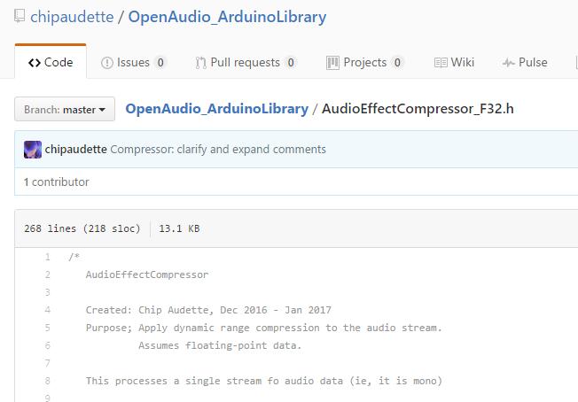

Slide 3
Original Audio
class BasicCompressor
setPreGain_dB
Pre-Process Signal
enableHPFilter
Level Estimator
setLevelTimeConst_sec
setCompressionRatio
Gain Calculator
setThresh_dBFS
setAttack_sec
Apply Gain
setRelease_sec
Processed Audio

Slide 4
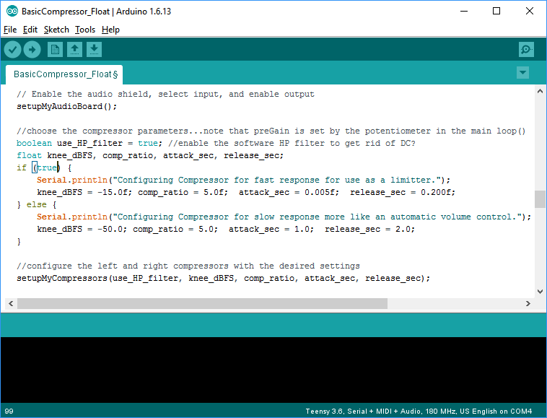
Choose!
“Fast”
“Slow”

Slide 5
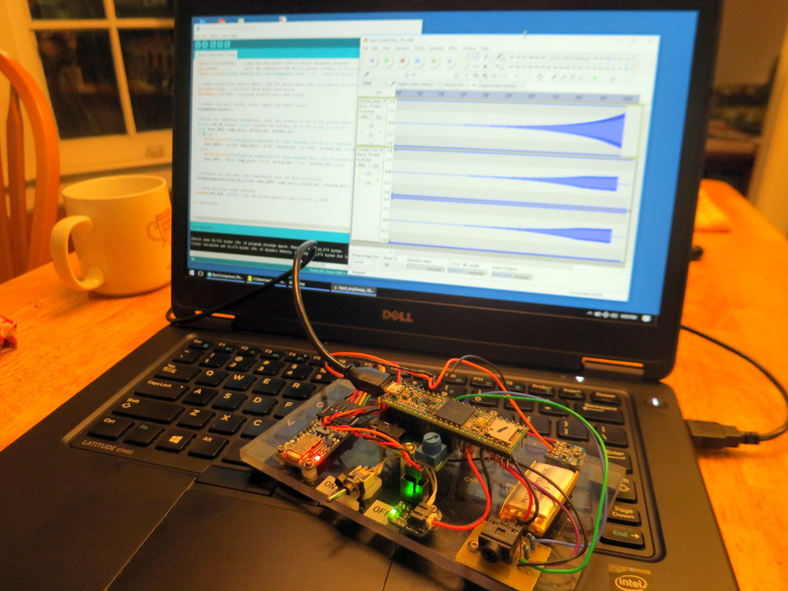
Arduino
IDE
Audacity
Recording
USB Audio Connection
My Teensy Hearing Aid

Slide 10
2 kHz Tone
Increasing Amplitude
Compressed!
2 kHz Tone
Increasing Amplitude
-15 dBFS
Compressed!

Slide 11
2 kHz Tone
Increasing Amplitude
Compressed!
-15 dBFS
Compressed!
Linear

